Slide 1

Java Class Stack
13.12.2020
Thomas Weyand
<Foliennummer>

Slide 2
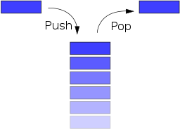
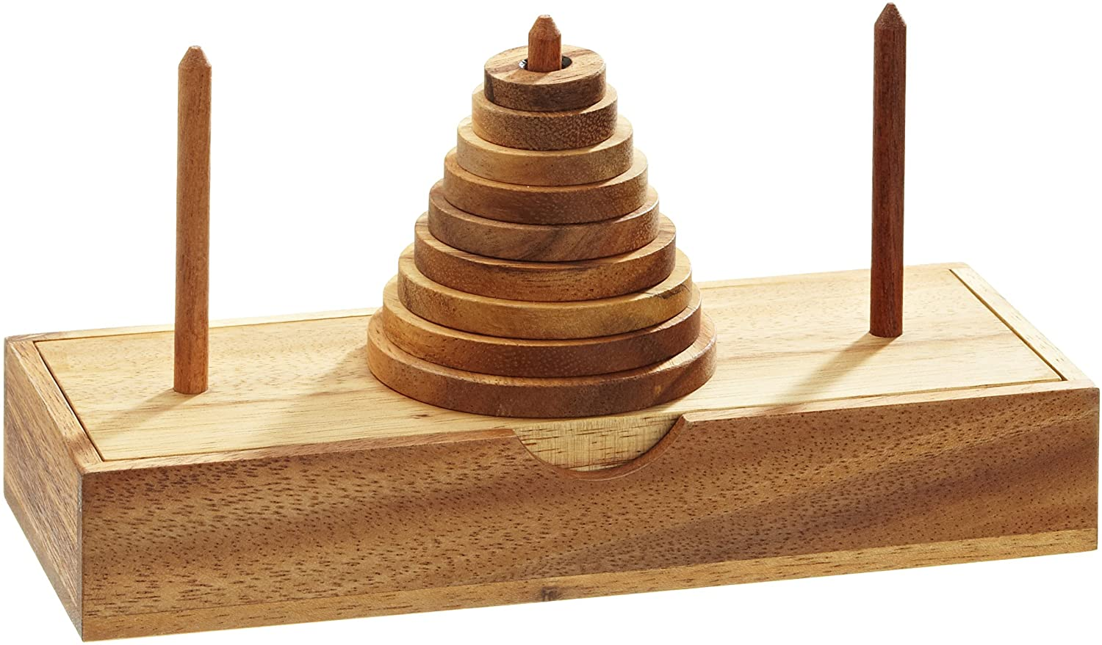
Java Class Stack
last-in-first-out (LIFO)
13.12.2020
Thomas Weyand
<Foliennummer>

Slide 3
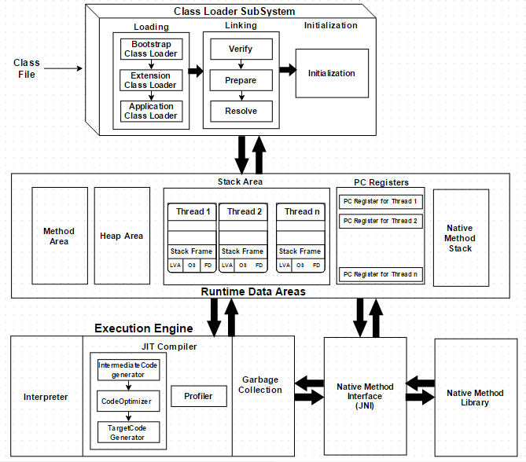
Java Class Stack
JVM
13.12.2020
Thomas Weyand
<Foliennummer>

Slide 4
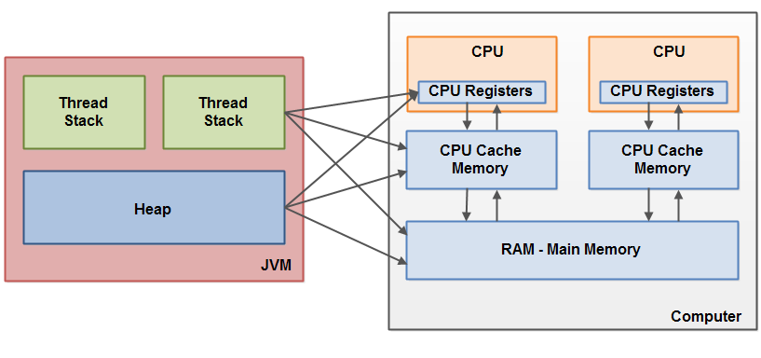
Java Class Stack
JVM ↔ Computer
13.12.2020
Thomas Weyand
<Foliennummer>

Slide 5
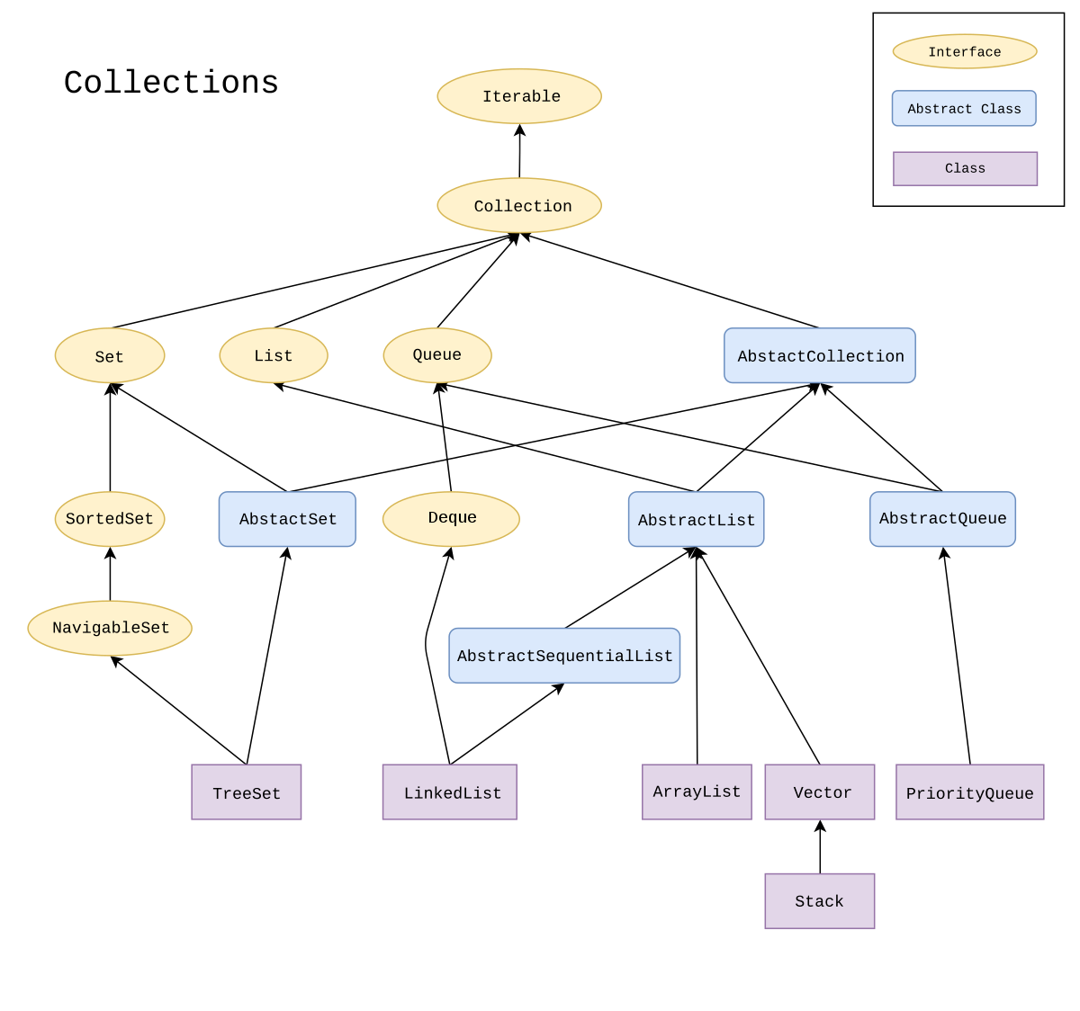
Java Class Stack
Collections
Module java.base
Package java.util
Class Stack<E>
java.lang.Object
java.util.AbstractCollection<E>
java.util.AbstractList<E>
java.util.Vector<E>
java.util.Stack<E>
You are here!
13.12.2020
Thomas Weyand
<Foliennummer>

Slide 6
Java Class Stack
<E> … was?!
Typparameter:
E - Element
K - Key
V - Value
T - Typ
(S,U,V etc.: 2., 3., 4. Typ)
N - Number
Stack<Integer> stack = new Stack<>();
Ich bin eine
Element-Typ
Definition
Ich bin ein
funkelnder
Diamant
Stichwort: Diamant-Typ-Inferenz-Operator
13.12.2020
Thomas Weyand
<Foliennummer>

Slide 7
Java Class Stack
Stack in den Java-Docs:
Module java.base
Package java.util
Class Stack<E>
java.lang.Object
java.util.AbstractCollection<E>
java.util.AbstractList<E>
java.util.Vector<E>
java.util.Stack<E>
All Implemented Interfaces:
Serializable, Cloneable, Iterable<E>, Collection<E>, List<E>, RandomAccess
13.12.2020
Thomas Weyand
<Foliennummer>

Slide 8
Java Class Stack
Konstruktor
Constructor | Description
Stack() | Creates an empty Stack.
13.12.2020
Thomas Weyand
<Foliennummer>

Slide 9
Java Class Stack
Methoden-Zusammenfassung
Modifier and Type | Method | Description
boolean | empty() | Tests if this stack is empty.
E | peek() | Looks at the object at the top of this stack without removing it from the stack.
E | pop() | Removes the object at the top of this stack and returns that object as the value of this function.
E | push(E item) | Pushes an item onto the top of this stack.
int | search(Object o) | Returns the 1-based position where an object is on this stack. (-1 if not found)
13.12.2020
Thomas Weyand
<Foliennummer>

Slide 10
Java Class Stack
9
Verwendung
4
4
1
1
2
3
4
5
6
7
8
9
10
11
12
13
14
15
16
17
18
19
20
import java.util.Stack;
public class Stapel {
public static void main(String[] args) {
Stack<Integer> stack = new Stack<>();
stack.push(1); // Methode push
stack.push(4);
stack.push(9);
int n = 4;
System.out.println("Die " + n + " befindet sich an Stelle " + stack.search(n)); // Methode search
System.out.println("Oberstes Element: " + stack.peek()); // Methode peek
stack.pop(); // Methode pop
System.out.println(stack.pop());
System.out.println("Der Stack hat " + stack.size() + " Element(e)"); // Methode size
System.out.println(stack.empty() ? "Stack ist leer" : "Stack ist gefüllt"); // Methode empty
}
}
13.12.2020
Thomas Weyand
<Foliennummer>

Slide 11

Java Class Stack
Quellen:
https://docs.oracle.com/en/java/javase/11/docs/api/java.base/java/util/Stack.html
https://www.techiedelight.com/stack-implementation-in-java/
Java ist auch eine Insel, Christian Ullenboom, Rheinwerk Computing, 15. Augabe
Bildnachweise:
https://en.wikipedia.org/wiki/Java_collections_framework
https://www.amazon.de/Philos-6220-Hanoi-Scheiben-Legespiel/dp/B0006A3JZC
https://www.javainterviewpoint.com/wp-content/uploads/2016/01/JVM-Architecture.png
https://i.guim.co.uk/img/media/b251ae63d78acf9389a8fce146580483ecdd2253/57_6_1416_849/master/1416.jpg?width=1020&quality=85&auto=format&fit=max&s=e3766daa18fdb5d5a46b2deae93240e9
https://www.pinterest.de/pin/212865519867303599/
13.12.2020
Thomas Weyand
<Foliennummer>

